Slide 1
New Technologies for Fossil Fuels
By: Carlos J. Vicente
Mónica Páez
Alessandro Di Nápoli
José Pablo Alvarado

Slide 2
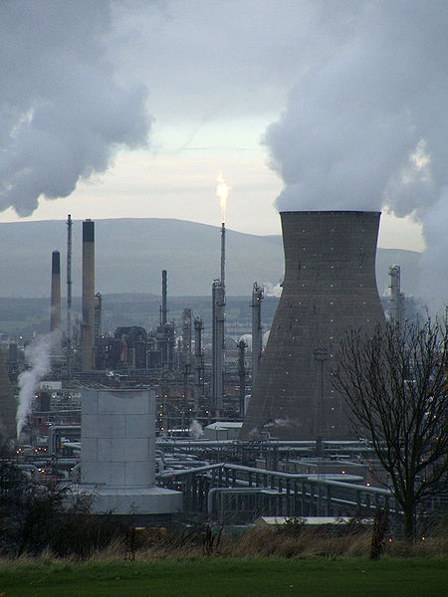
Main Issues with Fossil Fuels Emissions
High emissions of CO2
Due to its easy transport.
Lower inversions
Exaggerated use.

Slide 3
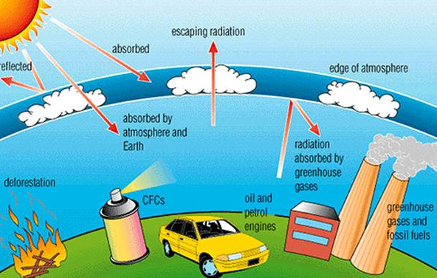
Effects of the emissions
Green house effect
Global warming
Pollution in Big Cities
- eg: Beijing

Slide 4
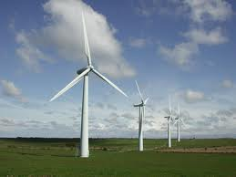
Caused the creation for new technologies
New energy resources:
Solar
Wind
Hydro electrical
Thermal
Nuclear
Low or none CO2 emissions
New technology for mitigating the CO2 emissions given out by fossil fuels.

Slide 5
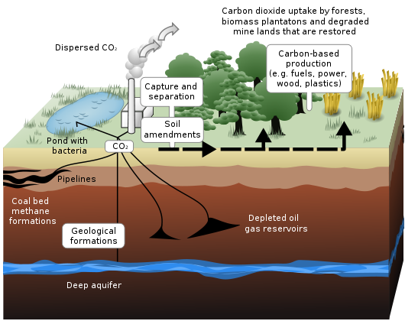
Carbon Capture Storage

Slide 6
What is it?
The CCS enables large reductions in CO₂ emissions.
Reduce, mitigate the contribution of fossil fuels.
Capture carbon from large point sources such as fossil fuel power plants, and storing it in such a way that it does not enter the atmosphere.
Recycle of C02 emissions.

Slide 7
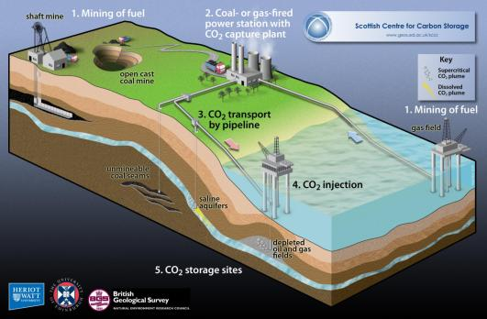

Slide 8
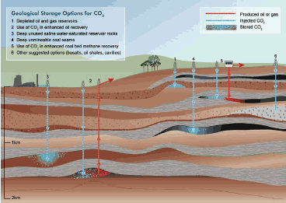
Transport
After capturing the CO2 it has to be transported into suitable storage sites.
Pipeline is the cheapest and best way.
Stored in either containers for that use or natural storage facilities (old oil and gas fields)

Slide 9
UK
Uk is one of the largest contributors on the emission of CO_{2.}
Good place to capture and store CO_{2,} has a lot of oil and gas fields which are being emptied of hydrocarbons.
space for about 5.3 Gt CO₂ in depleted oilfields (i.e. 5,300,000,000 tonnes)
Can gather 10 years of Co2 emmissons.

Slide 10
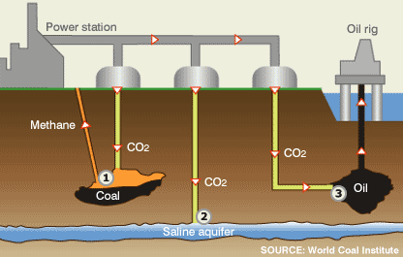
UK
Saline aquifers.
These are porous rocks deep below ground that are full of salty water.
Could store 19 - 716 Gt CO₂ like this (i.e. up to 716,000,000,000 tonnes)
About 500 years of UK emissions.

Slide 11
Oceans
Place to store carbon.
“Dissolution' injects CO₂ by ship or pipeline into the water column at depths of 1000 m or more, and the CO₂ subsequently dissolves.”
‘Lake' deposits CO₂ directly onto the sea floor at depths greater than 3000 m, where CO₂ is denser than water and is expected to form a 'lake' that would delay dissolution of CO₂ into the environment.”
“Convert the CO₂ to bicarbonates(using limestone) “
“Store the CO₂ in solid clathrate hydrates already existing on the ocean floor, or growing more solid clathrate.

Slide 12
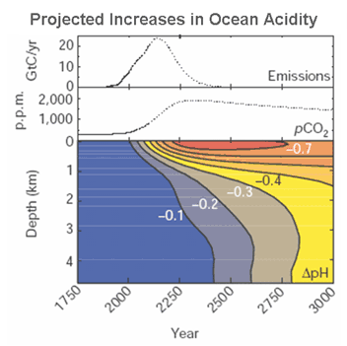
How does it affect the Oceans?
Half of the CO₂ in the atmosphere dissolves in the water.
The pH of the water increases.
May kill organisms in the ocean’s.

Slide 13
Limitations
The technology is expected to use between 10 and 40% of the energy produced by a power station
Levels of CO₂ decrease remain high, at approximately 80-90% compared to a plant without CCS
It is possible for CCS to give negative emissions however CCS and biomass is not developed enough

Slide 14
Safe and permanent storage of CO₂ cannot be guaranteed
CCS may still be economically attractive in comparison to other forms of low carbon electricity generation.

Slide 15
Enviromental Effects
During power production, CO₂ capture, transport and storage.
Mining and extraction of coal or gas
Plants require proportionally greater amounts of limestone and systems equipped with SCR
Air pollutants increase significantly, the use of CCS entails a reduction in air quality

Slide 16
Carbon Capture and Storage Association (CCSa)
Promotes the use of CCS.
Raise awareness of its benefits.
Advertises the potential it has to mitigate climate change.
Advises policy makers on the subject.
Having direct contact with industries which wish to use CCS.

Slide 17
Will it work?
Not a definite solution, yet helps reduce the quantity.
It is an scheme which will help until emissions themselves are cut down.
Starting point towards reducing the quantity of greenhouse gases.

Slide 18
Other Schemes
Several new alternatives to reduce the level of CO₂:
Cap and Trade (Quotas for Firms)
Taxing Emission.
Limit Emission (Amount of CO₂ per unit of energy)
Subsidies with CCS.
Legislations (Mandatory CCS)

Slide 19
Bibliography
www.co2storage.org.uk
www.wikipedia.org/wiki/Carbon_capture_and_storage
www.ccsassociation.org.uk
http://en.wikipedia.org/wiki/Fossil_fuel

